Slide 1


SMART INDIA HACKATHON 2024
Problem Statement ID - SIH 1699
Problem Statement Title - Let’s Learn constitution in a simpler manner-Institution perspective.
Theme- Miscellaneous
PS Category- Software
Team ID-
Team Name- Samvidhan Simplifiers

Slide 2
Let’s Learn Constitution in a Simpler Manner-Institution Perspective
Samvidhan Simplifiers
Importance of Legal Literacy: Legal literacy is crucial for the healthy functioning of democracy. The youth, as future leaders and policymakers, must understand the constitutional framework to actively participate in governance.
Vision: The aim is to bridge the gap between the framers of the Constitution and Indian citizens (आम आदमी) through a web application called "Constitution Unlocked: Simplifying Law for All."
Gamified Learning: The app will enhance users' understanding of the Indian Constitution by gamifying the learning process, making it engaging and interactive.
Proposed Solution: Constitution Unlocked simplifies the Constitution through user-friendly games and quizzes, making complex legal concepts easy to understand for all age groups.
Innovation & Impact: By making learning fun, this app addresses the gap in legal literacy, particularly among the youth, encouraging informed participation in governance.

Slide 3


TECHNICAL APPROACH
Samvidhan Simplifiers
Frontend: HTML, CSS, JavaScript, React.js
Backend: Express,Node.js, MySQL/MongoDB and other frameworks
APIs: RESTful APIs for quizzes and user interactions
Version Control: Git/GitHub

Slide 4
FEASIBILITY AND VIABILITY
Samvidhan Simplifiers
Feasibility Analysis:
- The idea is technically feasible using common web technologies and gamification tools.
- Development costs are manageable with open-source resources and cloud platforms.
Potential Challenges & Risks:
- Scalability: Increased user load could challenge the app’s performance.
- Content Accuracy: Ensuring legal content is correct and easy to understand.
Strategies for Overcoming Challenges:
- Phased Rollout: Start with basic features, expand gradually based on user feedback.
- Engagement Boosters: Add rewards, leaderboards, and social sharing.
- Scalability Solutions: Use cloud-based infrastructure for easy scaling.
- Expert Support: Collaborate with legal professionals to ensure content accuracy.

Slide 5
IMPACT AND BENEFITS
Samvidhan Simplifiers
Potential Impact on the Target Audience:
Increased Legal Awareness: Youth and citizens will gain a better understanding of their constitutional rights and duties.
Empowered Participation: Informed citizens will be more likely to engage in democratic processes and governance.
Educational Engagement: Gamified learning can attract and retain the interest of younger audiences, enhancing their knowledge in a fun way.
Bridging Knowledge Gaps: The app will simplify complex legal concepts, making constitutional knowledge accessible to all.
Benefits of the Solution:
Social: Promotes legal literacy and informed citizenship, strengthening democratic values.
Economic: An educated population can lead to better governance, indirectly boosting economic development by making citizens aware of their rights.
Cultural: Encourages respect for the rule of law and civic responsibility.
Environmental: Digital education reduces the need for physical resources like books, contributing to sustainability efforts.

Slide 6
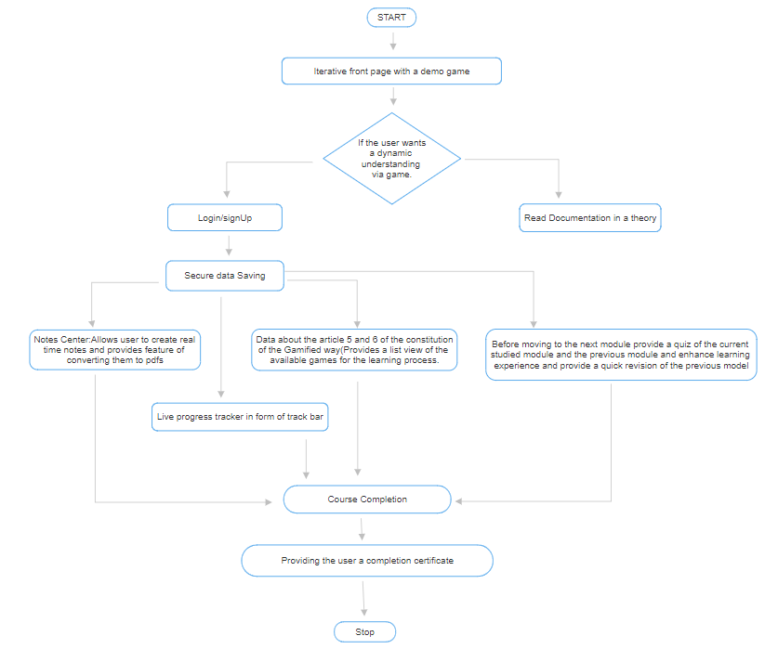
Samvidhan Simplifiers
FLOW DIAGRAM
READ ARTICLES

Slide 7
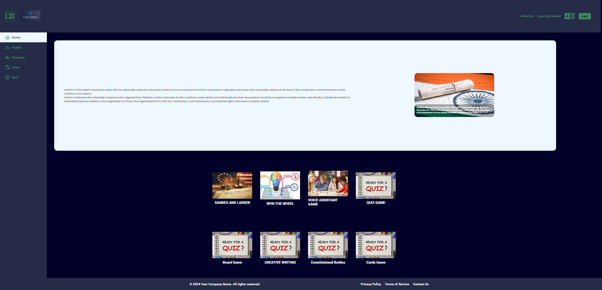
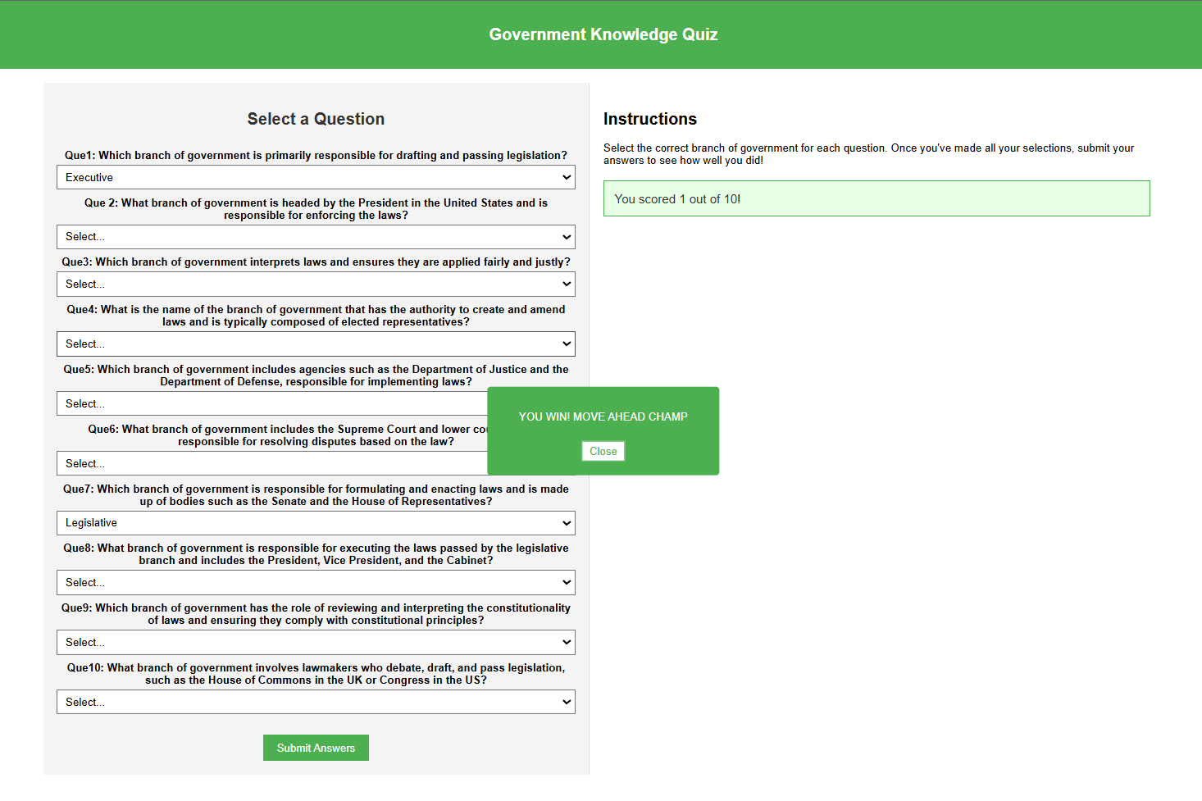
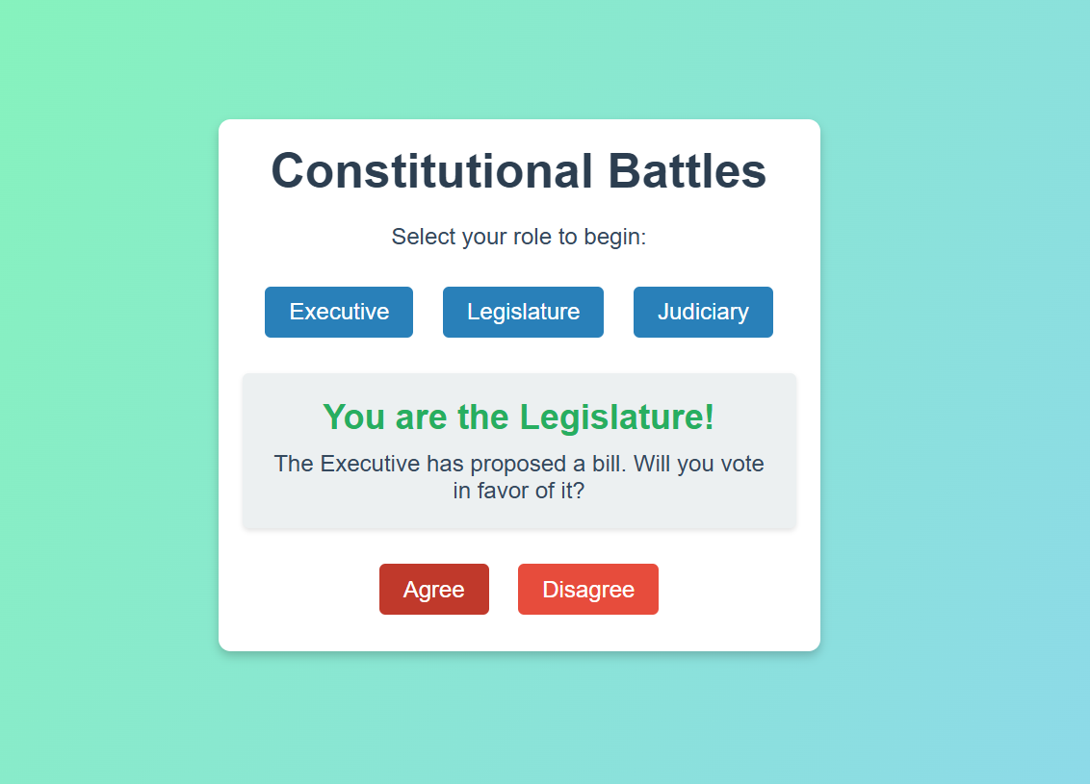

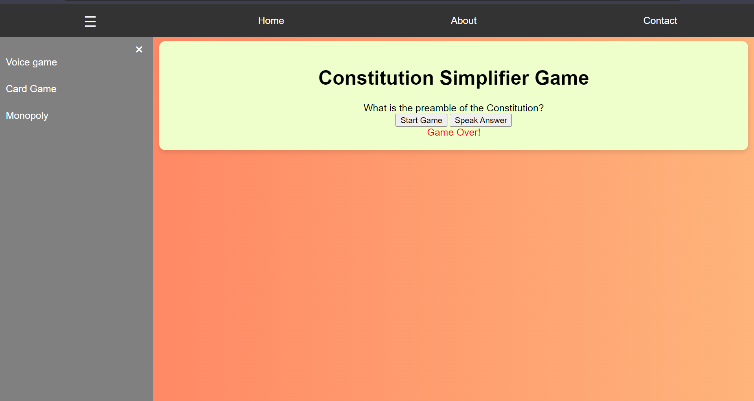
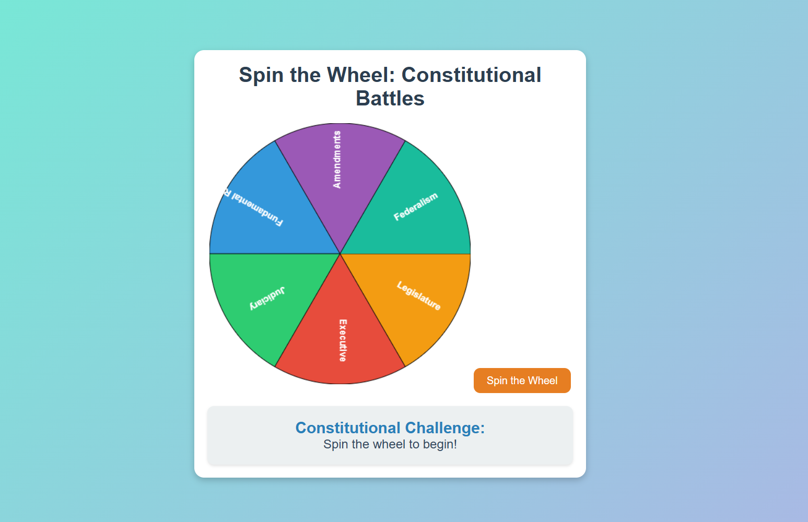
PROTOTYPES

Slide 8
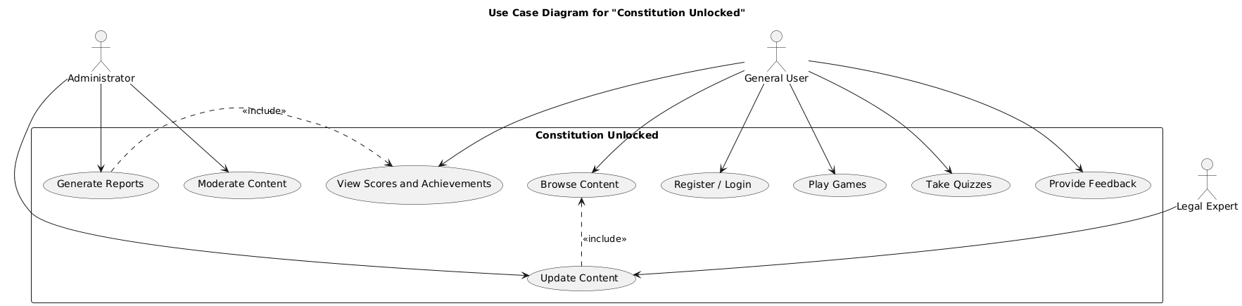
Samvidhan Simplifiers

Slide 9
TEAM MEMBERS
Samvidhan Simplifiers
TEAM MEMBER 1 - VAIBHAV KHANDELWAL
TEAM MEMBER 2 - SWAYAM GUPTA
TEAM MEMBER 3 - SIDDHANT SAXENA
TEAM MEMBER 4 - DIVYANSH RASTOGI
TEAM MEMBER 5 - DIVYANSHI TYAGI
TEAM MEMBER 6 - BIKRAM MISTRY

